Slide 1
CS 6330 Final Project
Human Gait Analysis
Dan Olson
Rich Lukas
Robert Burkhardt

Slide 2
CS 6330 Final Project
Problem Statement
The Goal of this project was to collect time series data from an IMU, and use it to identify individuals and activities
Gait is the cyclic movement of the body during locomotion
Gait can be broken down into the Stance phase and Swing phase
Stance Phase Stance Phase
Heel Strike Acceleration Phase
Foot Loading Mid-Swing
Midstance shift Deceleration Phase
Heel-off
Toe-off
Movement is highly individualized and unique to each person
Typical tools consist of stop motion photography, pressure sensors, and accelerometers strapped to the body.

Slide 3
CS 6330 Final Project
Methodology
Data Collection
Three test subjects were outfitted with a 6 axis IMU, which recorded angular velocity and acceleration
Data was collected at 500 hz and then down sampled to 100 hz
The sensor was mounted at the hip
The recorded activities included
Walking at a measured pace
Running
Stair climbing/descending
Treadmill
Sitting
Jumping
Standing

Slide 4
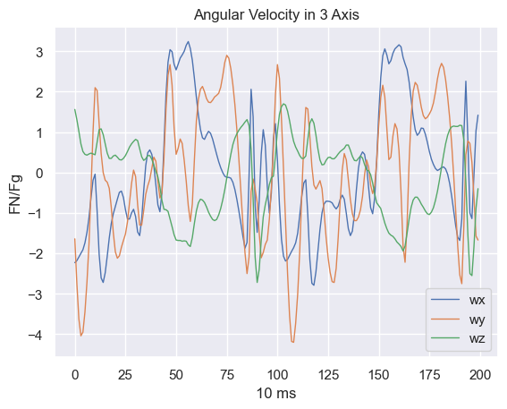
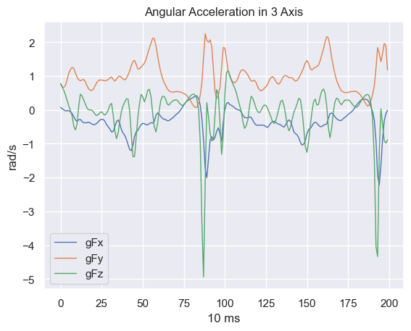
CS 6330 Final Project
Visualization
Visualization of IMU Data Walking at 1 step per second
Not Angular

Slide 6
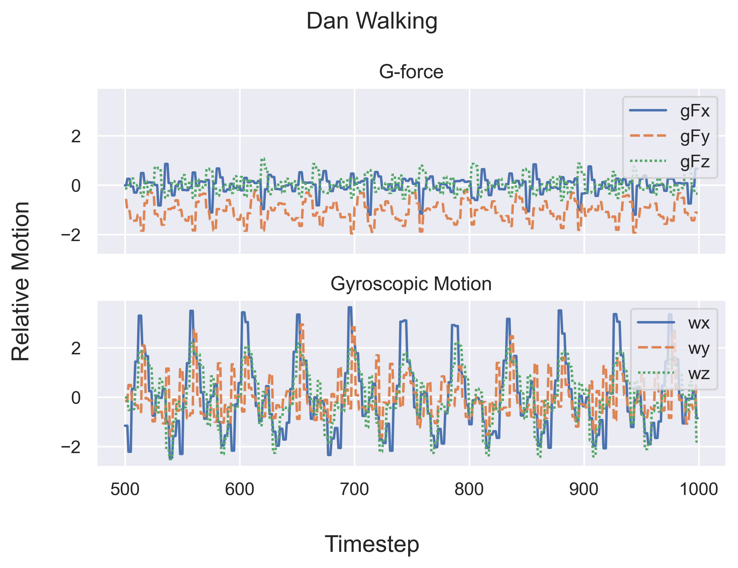
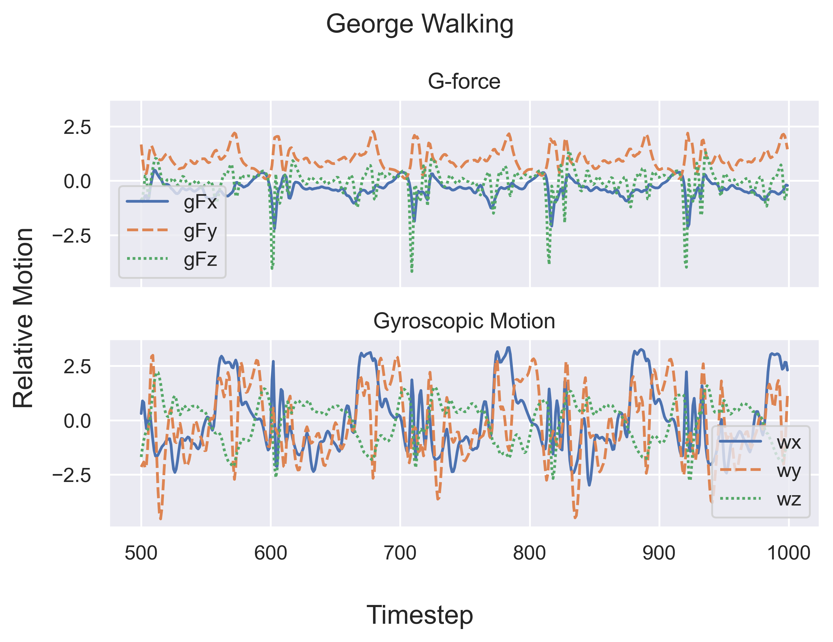
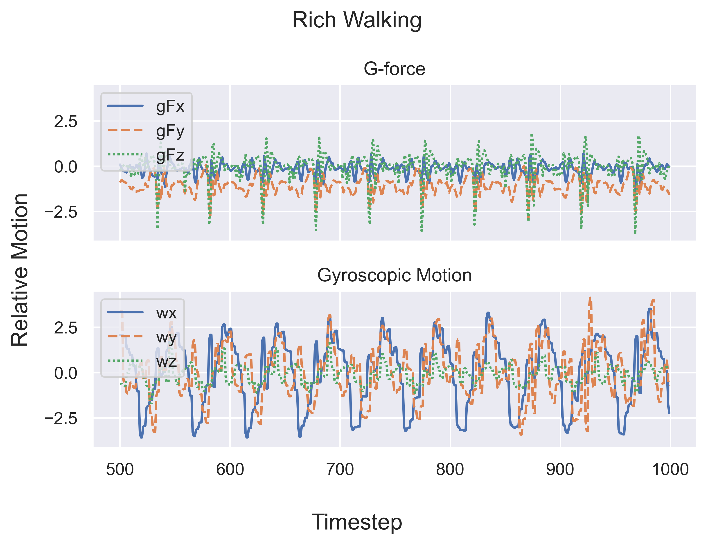
Uniqueness of Gait
Visualization
Angular Velocity
Angular Velocity
Angular Velocity

Slide 7
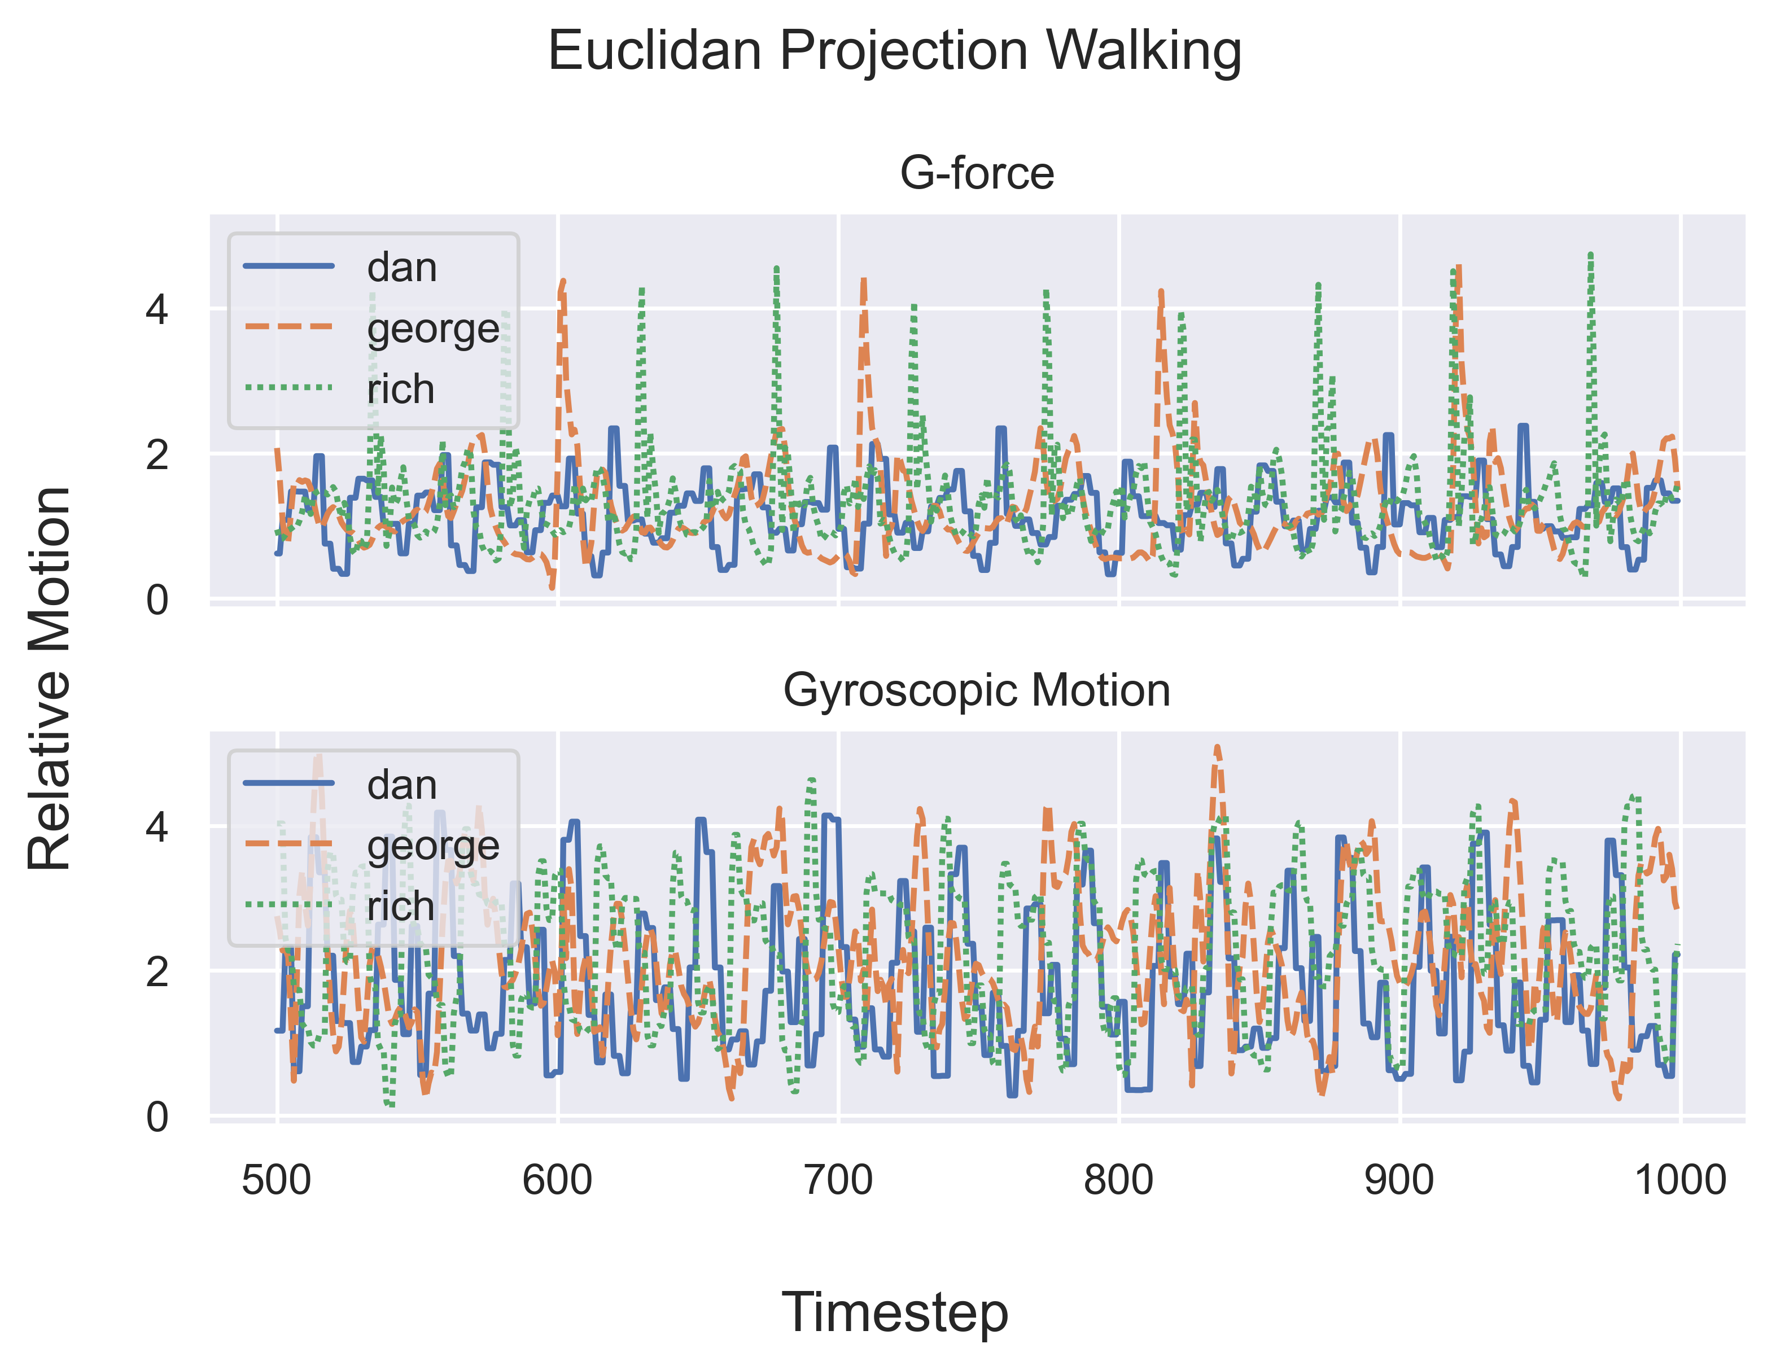
Uniqueness of Gait
Visualization

Slide 8
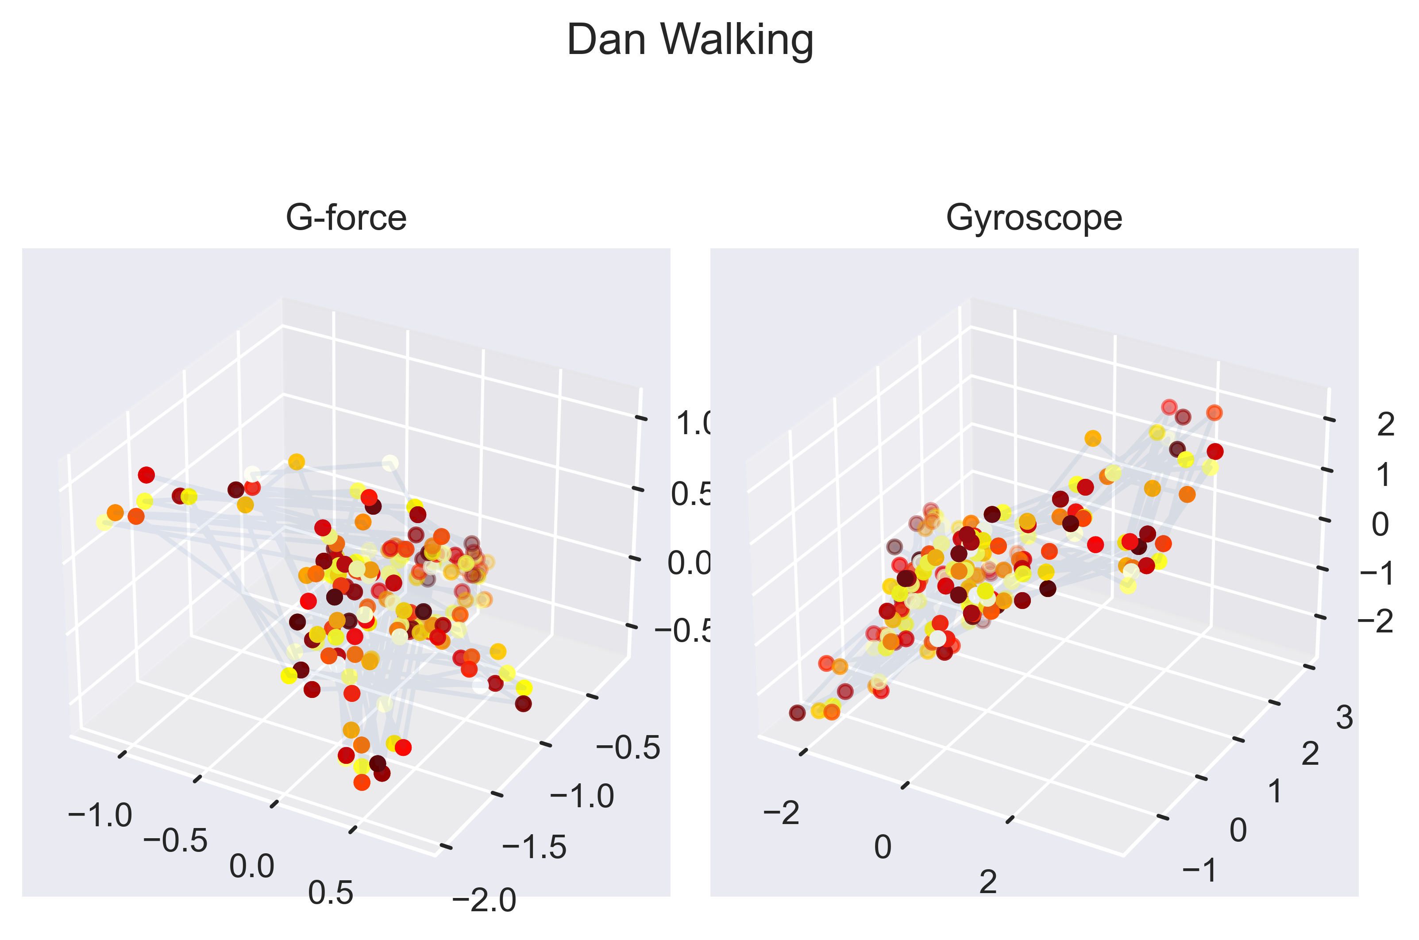
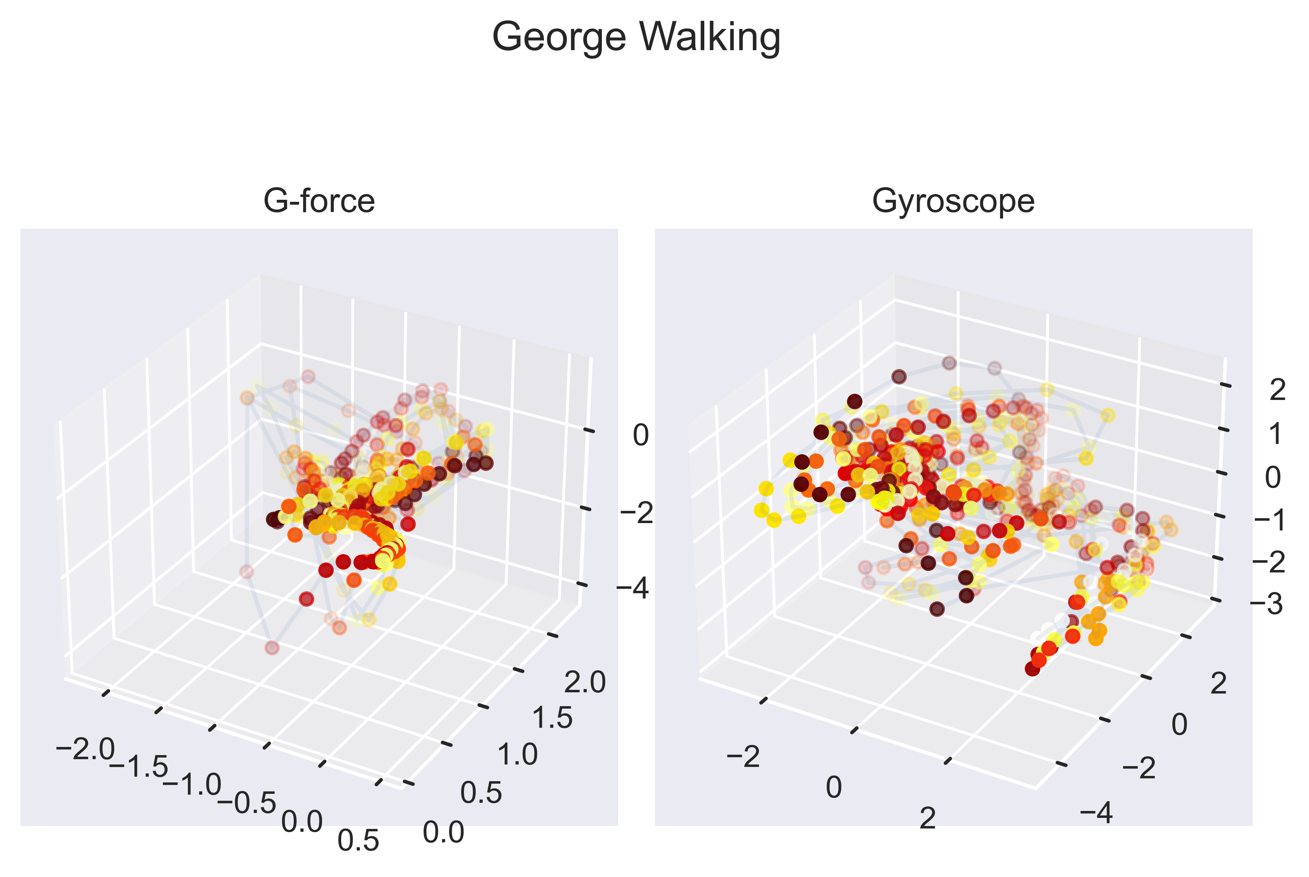
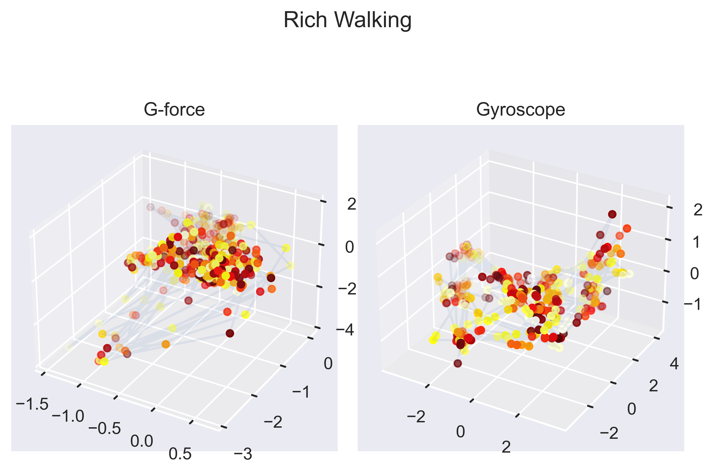
Forces in 3-space
Visualization

